Slide 1
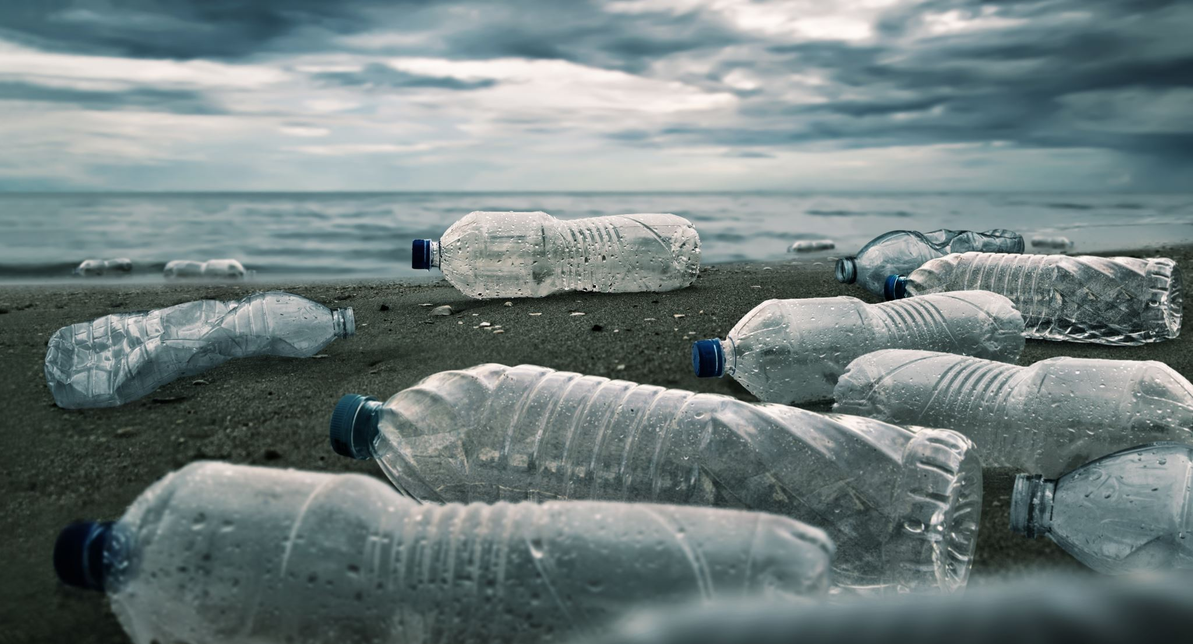
Waste Water Management
By Aarsh Rathi

Slide 2
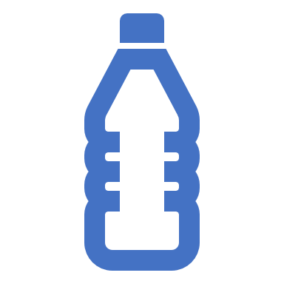

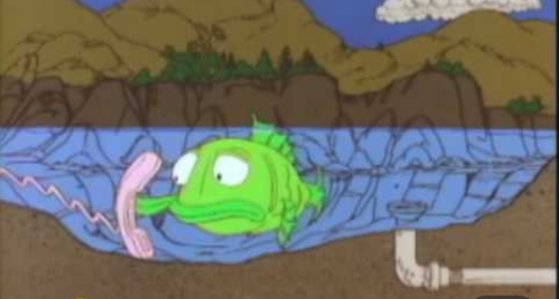
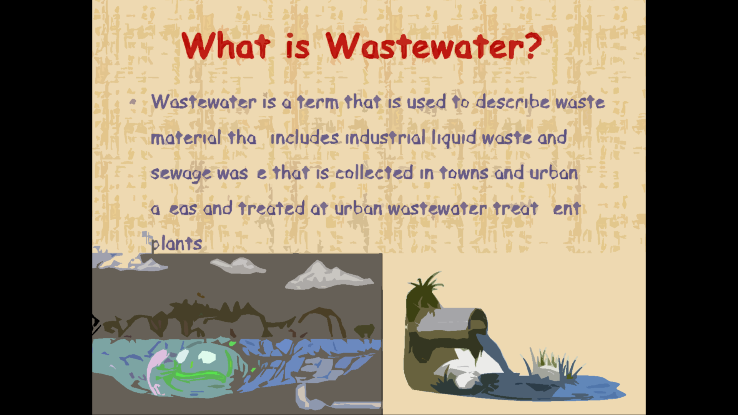
What is Wastewater?
Wastewater means any water not clean or of adequate quality. The Wastewater originate from combination of some following domestic, industrial, commercial, or some agriculture activities.

Slide 3

What is Wastewater Management?
Wastewater treatment or management refers to the processes used to convert wastewater that can be either returned to the water cycle with negligible environmental impact or can be reused.

Slide 4
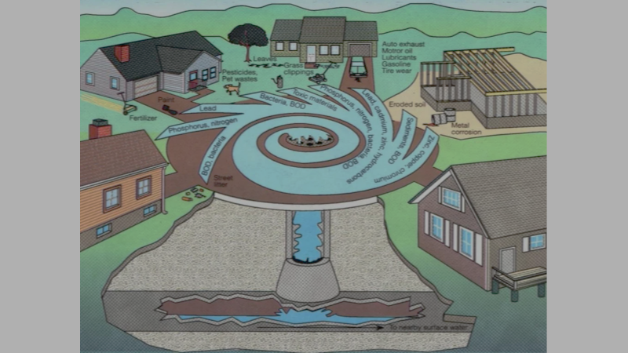
Where does waste water come from?
Residences (human and animal excreta and water used for washing, bathing and cooking.)
Commercial institutes (dairy and industrial establishment slaughter house waste, dairy wastewater etc.)

Slide 5
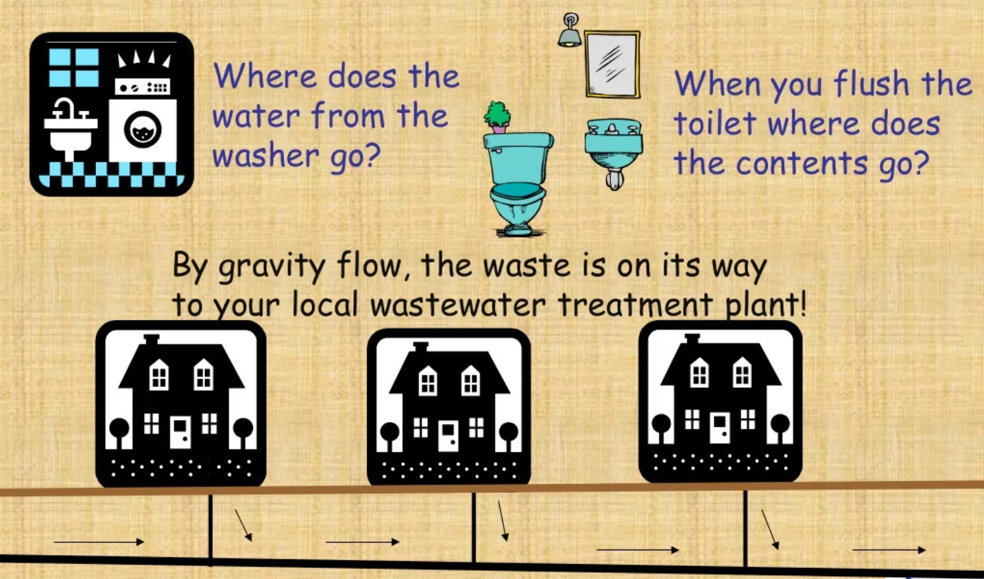
Where does it all go

Slide 6
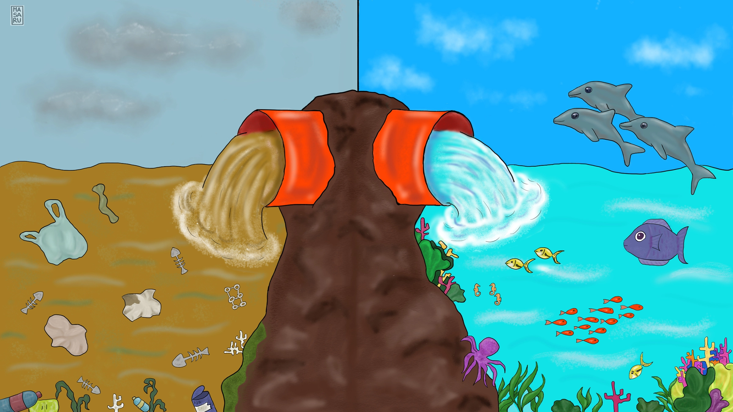
Why treat waste water??
Benefits of WWT
Causes as demand of dissolved oxygen.
Adds nutrients (nitrate and phosphate)to cause excessive growth.
Increases suspended solids in the stream.
It reduces organic content i.e BOD.
Removal of nutrients i.e nitrates and phosphates.
Removal of pathogenic microbes.

Slide 7
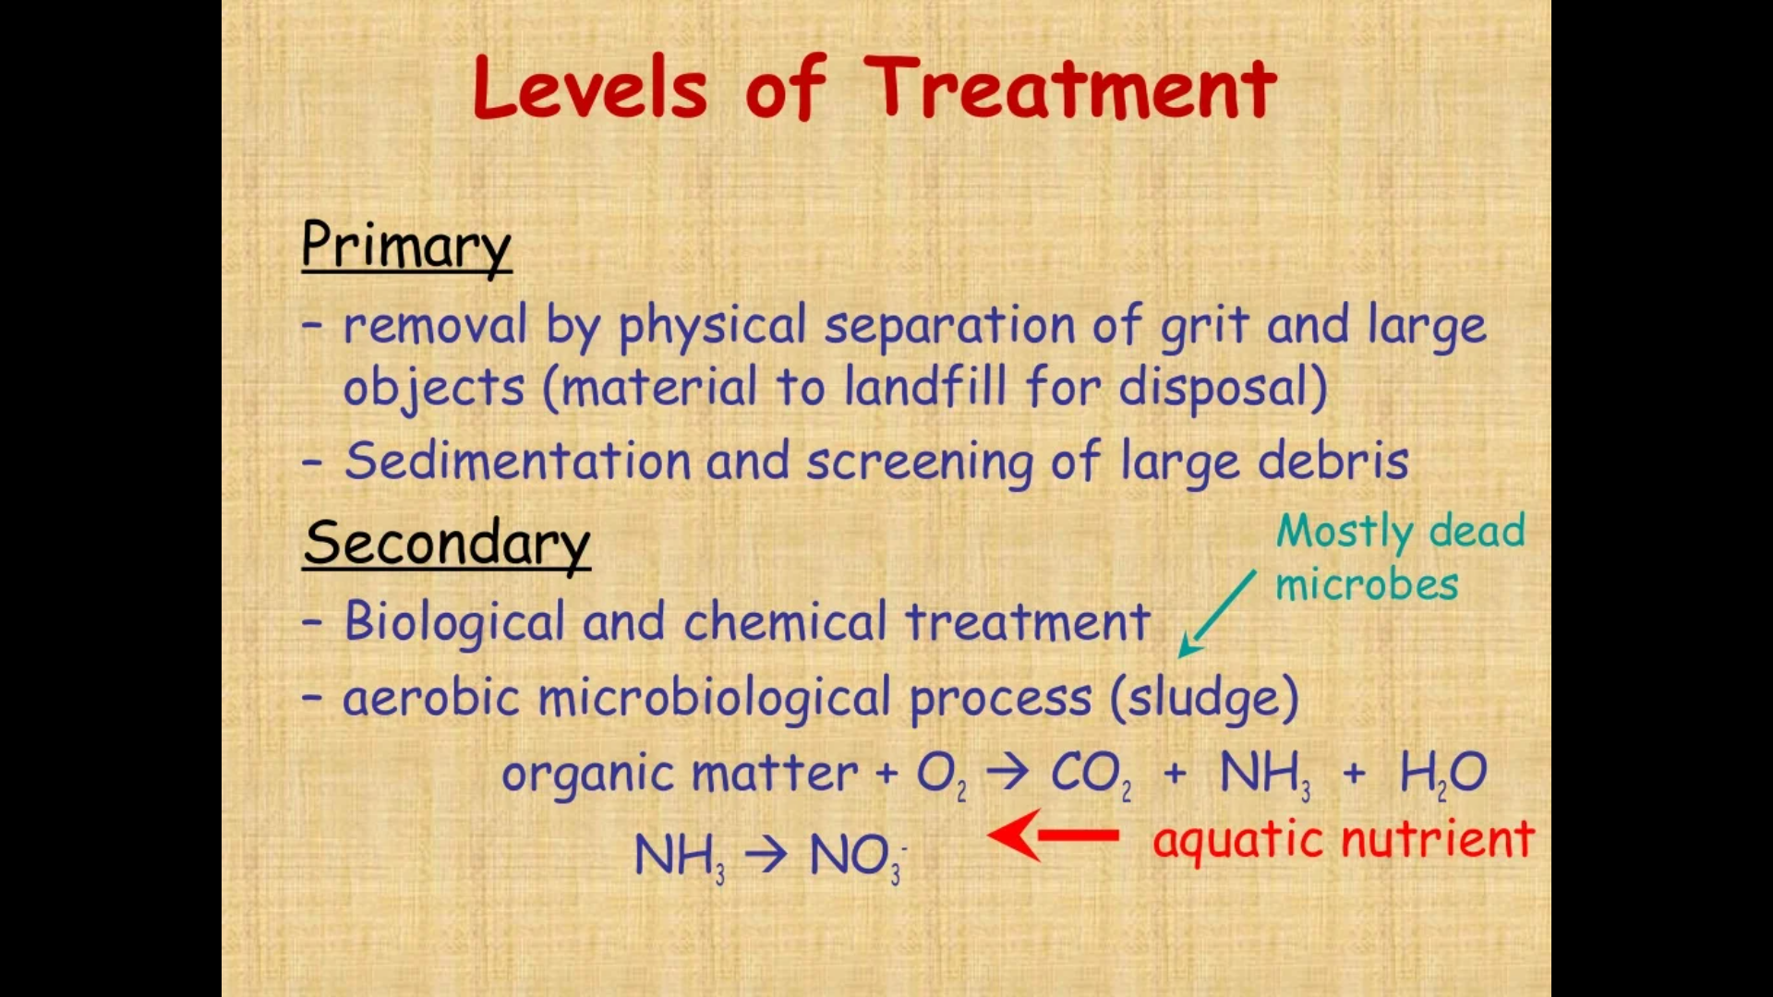
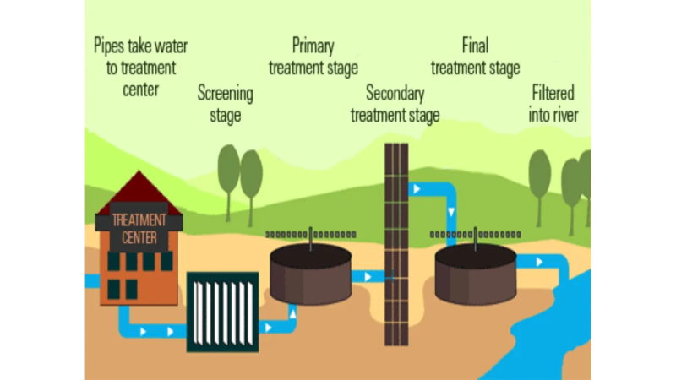

Slide 8
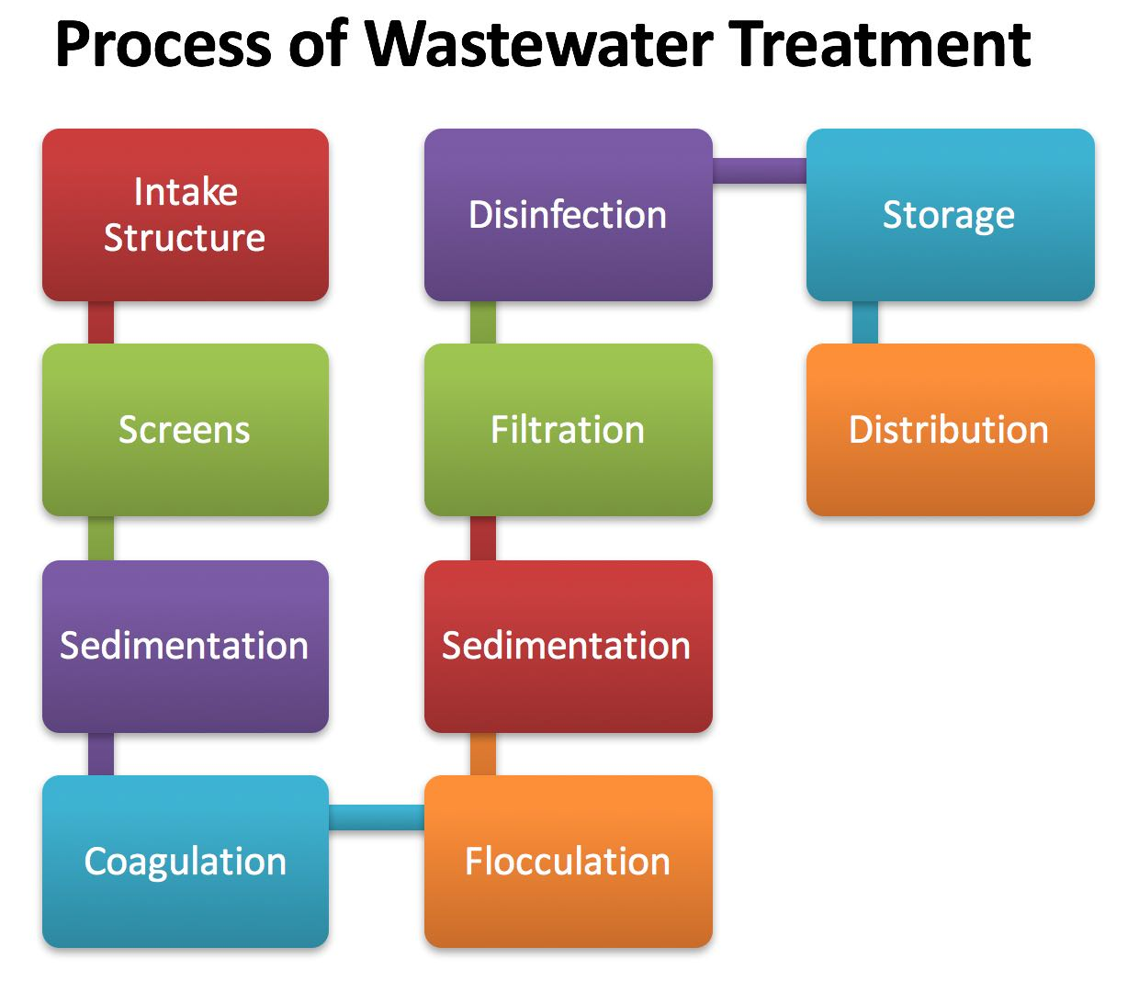

Slide 9
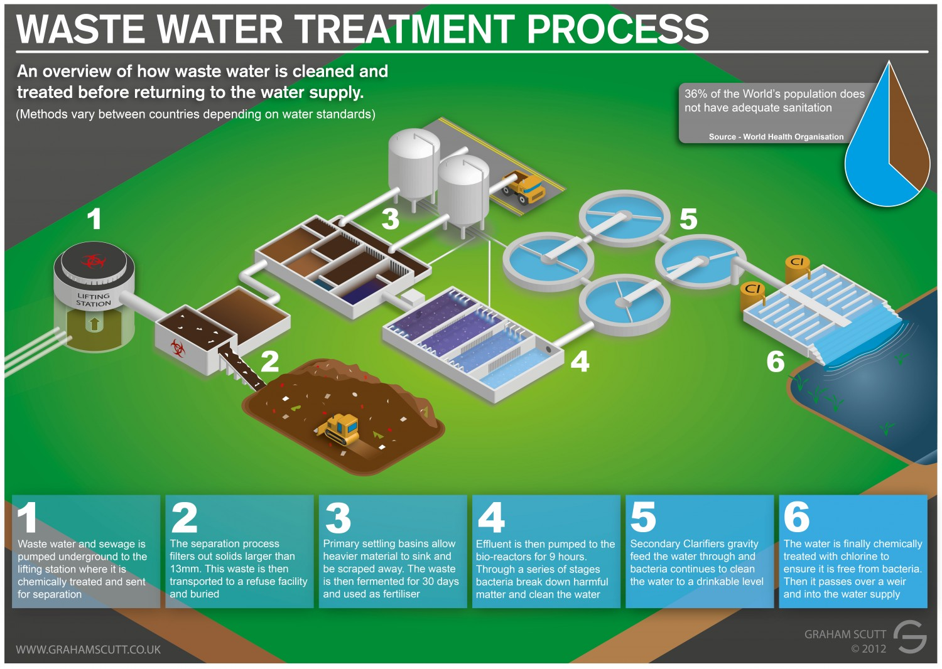

Slide 10
Wastewater Management Process
Phase Separation transfers impurities into a non-aqueous phase.
Sedimentation is a physical water treatment process using gravity to remove suspended solids from water.
Filteration: Suspension of fine solids may be removed by filtration through physical barriers such as coarser screens or sieves.
Oxidation diminishes the biochemical oxygen demand of wastewater and may reduce the toxicity of some impurities.

Slide 11
Wastewater Management Types
Domestic Wastewater Management
Industrial Wastewater Management
Agricultural Wastewater Management

Slide 12
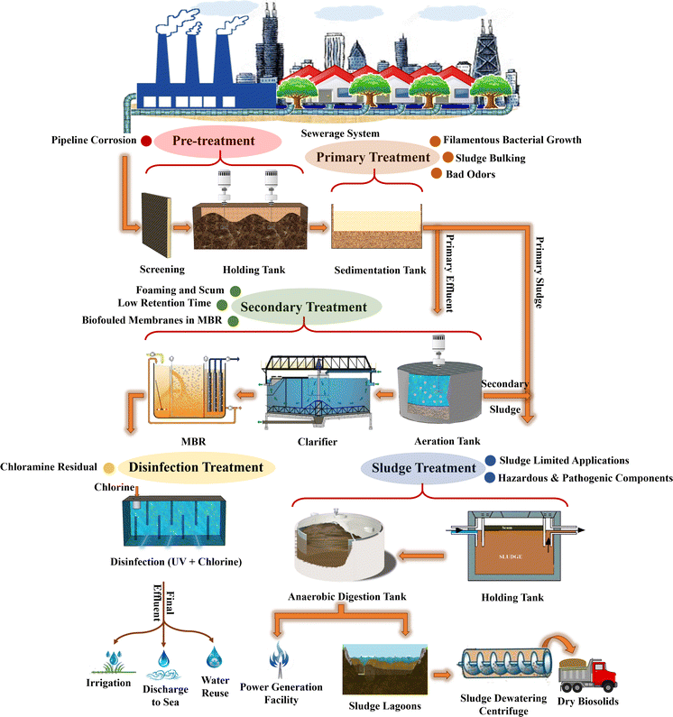
Domestic Wastewater Management
Domestic wastewater management is a type of wastewater treatment which aims to remove contaminants from sewage to produce an effluent that is suitable for discharge to the surrounding environment or an intended reuse application, thereby preventing water pollution from raw sewage discharges.

Slide 13
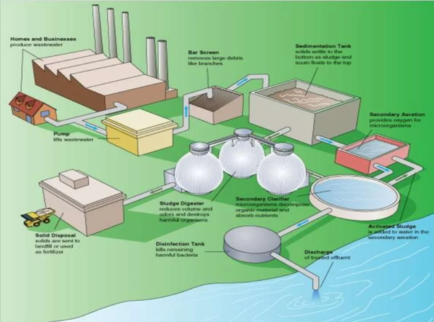
Industrial Wastewater Management
Industrial wastewater treatment describes that the processes that is used for treating wastewater that is produced by industries as an undesirable by-product. After the treatment, the treated industrial wastewater (or also an effluent) may had been reused or released to sanitary sewer or to a surface water in the environment.

Slide 14
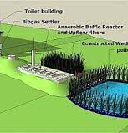
Agricultural Wastewater Management
Agricultural wastewater treatment is a farm management agenda for controlling pollution from confined animal operations and from surface runoff that may be contaminated by chemicals in fertilizer, pesticides, animal slurry, crop residues or irrigation water. Agricultural wastewater treatment is required for continuous confined animal operations like milk and egg production.

Slide 15
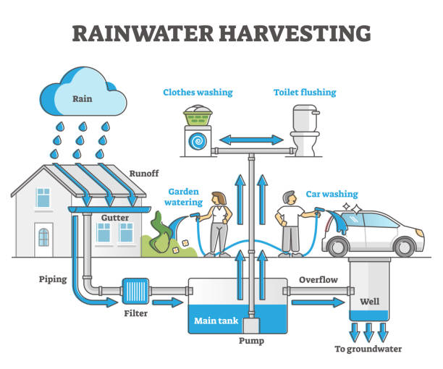
What is Rainwater Harvesting?
Rainwater harvesting is the simple, economical and ecofriendly process or technology used to conserve rainwater by collecting, storing, conveying and purifying of rainwater that runs off from rooftops, parks, roads, open grounds, wells etc. through small diameter pipe for later use.

Slide 16
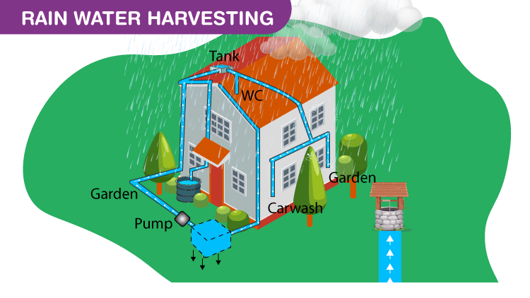

Slide 17
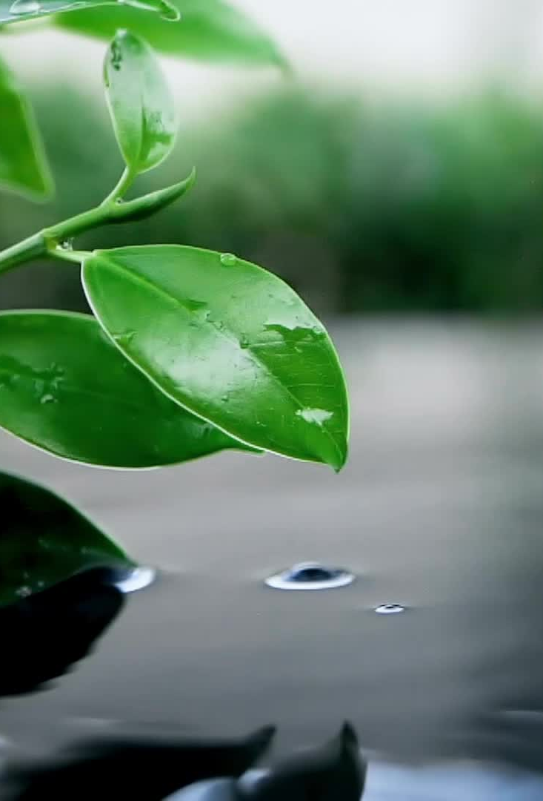
Why to harvest Rainwater?
Scarcity of good quality water has become a significant cause of concern.
Excessive dependence on limited groundwater.
Rapid urbanization has drastically decreased recharging of ground water.
However, rainwater, which is pure and of good quality, can be used for irrigation, washing, cleaning, bathing, cooking etc.

Slide 18
Advantages of Rainwater Harvesting
Less cost. Saves energy to lift ground water. One metre raise in water level saves about 0.40 kilowatt hour of electricity.
Helps in reducing the water bill.
Decreases the demand for water.
Reduces the need for imported water.
Promotes both water and energy conservation.
Improves the quality and quantity of groundwater.
Raises water level in wells and borewells.
Does not require a filtration system for landscape irrigation.
This technology is relatively simple, easy to install and operate.
It reduces soil erosion, stormwater runoff, flooding, and pollution of surface water with fertilizers, pesticides, metals and other sediments.
It is an excellent source of water for landscape irrigation with no chemicals, dissolved salts and free from all minerals.

Slide 19
Techniques of Rainwater Harvesting

Slide 20
Rainwater Harvesting Methods
In Rooftop Rainwater Harvesting, the rooftop becomes the catchments, and the rainwater from the building and houses are collected.
Surface Runoff Harvesting is the system that collects rainwater, which flows away as surface runoff. The runoff rainwater is caught and used to recharge aquifers by adopting appropriate techniques.

Slide 21
Thank You

